Slide 1

Aerospace API: Aircraft Maintenance Management Solution
Owen Lindsey
Professor Sparks, James
Milestone 3
10/20/2024

Slide 2

Project Overview
Purpose: - Efficient management of aircraft maintenance data.
- Centralized system for tracking aircraft performance and maintenance history.
2. Key Features:
- Aircraft data management.
- Maintenance record tracking.
- Performance metric monitoring .
3. Main Endpoints:
- /api/aircraft: manage aircraft information.
- api/maintenance: Handle maintenance records.
- api/performance: Track performance metrics.

Slide 3

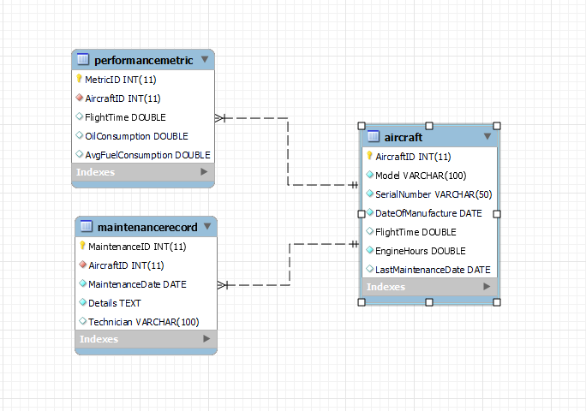
API Structure
Database Schema
Table | Use case
`performancemetric` | Tracks key performance indicators. MetricID is the primary key. Links to the `aircraft` table with AircraftID (foreign key).
`maintenancerecord` | Captures all maintenance related activities. MaintenanceID is this tables primary key. Links to the `aircraft` table with AircraftID (foreign key).
`aircraft` | AircraftID serves as the primary key and uniquely identifies each entry. Stores the model number, serial number, date of manufacture, flight time, etc.

Slide 4

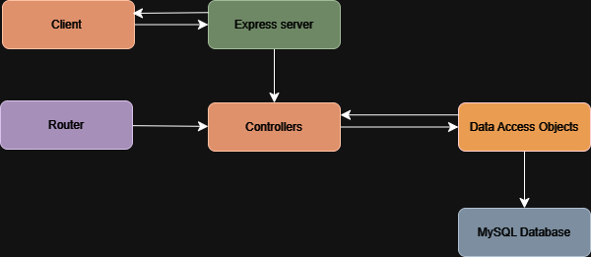
Architecture diagram
Component | Use
Client | Any web browser. For example, I am using Brave a chromium-based browser.
Express server | Handles HTTP request and responses.
Router | Directs requests to appropriate controllers.
Controller | Manage business logic and requests / response handling.
DAO | Interface with the database, performing our CRUD operations.
MySQL | Our database for this project.

Slide 5

Aircraft endpoints
HTTP method | Endpoint | Purpose
GET | http://localhost:5000/api/aircraft http://localhost:5000/api/aircraft/2 | Requests all aircraft data from `aircraft` table. Request all aircraft data from AircraftID 2.
POST | http://localhost:5000/api/aircraft | Creates a new aircraft.
PUT | http://localhost:5000/api/aircraft/2 | Overwrites flightTime, EngineHours, LastMaintenanceDate for AircraftID 2.
DELETE | http://localhost:5000/api/aircraft/1 | Deletes all data in row identified with the AircraftID of 1.

Slide 6
Maintenance endpoints
HTTP method | Endpoint | Purpose
GET | http://localhost:5000/api/maintenance http://localhost:5000/api/maintenance | Requests all maintenance data from `maintenance` table. Request all maintenance data from AircraftID 2.
POST | http://localhost:5000/api/maintenance | Creates a new maintenance.
PUT | http://localhost:5000/api/maintenance/2 | Overwrites maintenance date, details, and technician name for AircraftID 2.
DELETE | http://localhost:5000/api/maintenance/1 | Deletes all data in row identified with the AircraftID of 1.

Slide 7
Performance endpoints
HTTP method | Endpoint | Purpose
GET | http://localhost:5000/api/performance http://localhost:5000/api/Performance/21 | Requests all performance data from `performancemetric` table. Request all performance data from MetricID 21.
POST | http://localhost:5000/api/Performance | Creates a new entry of performance metrics.
PUT | http://localhost:5000/api/Performance/21 | Overwrites flight time and oil consumption of the MetricID 21.
DELETE | http://localhost:5240/api/PerformanceMetrics/9 | Deletes all data in row identified with the MetricID of 1.

Slide 8

Challenges Encountered
Challenges | Reasoning | Example | solution
Data Consistency | Challenge: Ensuring that all related data remains consistent across different tables, especially when updating or deleting records. | Deleting an aircraft record without properly handling its related maintenance and performance records could lead to orphaned data or integrity issues. | Implementing cascading deletes in the database schema and careful transaction management in the API logic.
Date and Time handling | Managing and standardizing date and time data across different operations, especially considering potential timezone differences. | Storing maintenance dates in UTC but displaying them in local time, or handling date formats consistently between client requests and database storage. | Adopting a consistent date-time handling strategy, possibly using libraries like Moment.js, and clearly documenting date-time expectations in the API.
Error Handling and Input Validation | Implementing comprehensive error handling and input validation to ensure the API behaves predictably and provides useful feedback. | Dealing with various edge cases, such as invalid aircraft IDs, malformed date inputs, or attempting to create duplicate records. | Implementing middleware for input validation, creating custom error classes, and setting up global error handling to provide consistent, informative error responses across all endpoints.

Slide 9

Pending bugs and current limitations
Current limitations | Future improvements
The API is currently designed and tested only in a local environment, which may not reflect real-world environments. | Potentially Dockerize the application for easier deployment and scaling
The error handling could be more robust and informative. | Add HTTPS support for more secure communication in prod environment.
The database has not been tested with large amounts of data or high simultaneous usage. | Possibly adding more features as time allows such as report generation and notification system for routine scheduled maintenance actions.

Slide 10

Lessons learned
Key take away | Explanation | Lesson
Importance of modular design | Separating concerns (routes, controllers, DAOs) made the codebase more manageable and easier to debug. | Separating concerns is helpful for a few reasons. Security, scalability, and maintainability is addressed by separating concerns.
Middleware importance | Separating configuration from code is crucial for maintainability and security. | Using .env files for configuration made the application more flexible and secure.
Database Design | A well-structured database schema simplified query writing and improved data integrity. | Investing time in proper database design pays off in the long run.

Slide 11

Application to future web projects
Key take away | Lesson
Start with a Clear Architecture | Begin future projects by outlining a clear, modular structure before coding. This will save time and reduce refactoring needs later.
Implement Comprehensive Logging Early: | Integrate detailed logging from the project's start to aid in debugging and monitoring. This practice will be invaluable as projects grow in complexity.
Focus on API Documentation | Prioritize creating and maintaining comprehensive API documentation. Good documentation saves time in the long run and improves the developer experience for API consumers.

Slide 12


Postman documentation and live demo
Postman document
Operation of Maintenance endpoints video
Operation of Maintenance endpoints video
Operation of performance endpoints video

Slide 13
Live demonstration with my commentary
Live demo

Slide 14
Questions?

Slide 15

API code location
Aerospace API

